Slide 1
An Analysis of Airline Flight Delays
Presented By:
David Musili
Moez Vellani
Sam Farrow
January 10th, 2024

Slide 2

Agenda
01. Project Overview
02. The Data
Provide an executive summary of our project.
Discuss the data used. This includes
The Source of the Data
Data Cleanup Process
Exploration Processes
03. First Quarter Data Analysis
04. Second Quarter
Data Analysis
05. Third Quarter Data Analysis
06. Conclusion
Provide an in-depth analysis of data from the First Quarter
Provide an in-depth analysis of data from the Second Quarter
.
Provide an in-depth analysis of data from the Third Quarter
Conclusions drawn from our project
January 4, 2024

Slide 3
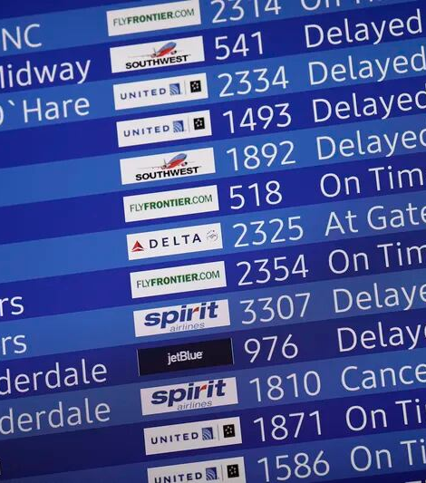
1. Project Overview
The primary goal of this project is to comprehensively analyze and understand the factors contributing to airline flight delays, with a focus on identifying patterns and root causes.
By leveraging extensive data and advanced analytics, our aim is to provide insights that can be utilized by airlines, regulatory bodies, and industry stakeholders to improve overall operational efficiency and passenger satisfaction.
January 4, 2024

Slide 4

2. The Data

Slide 5

Data Quote
“Data is a precious thing and will last longer than the systems themselves”
- Tim Berners-Lee

Slide 6
About the Data
Source of Data
The data used in this project was obtained from the U.S. Department of Transportation’s Bureau of Transportation Statistics.
Context
The U.S. Department of Transportation's (DOT) Bureau of Transportation Statistics tracks the on-time performance of domestic flights operated by large air carriers. This summary information on the number of on-time, delayed, canceled, and diverted flights is published in DOT's monthly Air Travel Consumer Report and in this dataset of 2015 flight delays and cancellations.
Acknowledgements
Department of Transportation (DOT) Bureau of Transportation Statistics.
License
CC0: Public Domain

Slide 7

Source Files
1. Airlines.csv
2. Airports.csv
3. Flights.csv
IATA airline codes and names
IATA airport codes and names
Contains a list of flights by each airline, departure and destination airports, and information on whether the flight was on time or delayed. If the flight was delayed, it also lists the reason for the delay
Acknowledgements
The csv files noted above were downloaded from Kaggle.

Slide 8
Data Clean Up
How we cleaned up the data
This project’s primary dataset is the flights.csv file (which consists of the flight data). In order for our team to do the data analysis, the data had to be cleaned in the following ways
Rows containing null values for the arrival and departure times were removed
Some of the columns not needed for analyzing flight delays were removed.
The flight data was merged with data from the airlines.csv file. This enabled our reports to use the airline name and not the IATA airline code e.g. American Airlines instead of ‘AA’.
The flights were grouped by individual airlines and then summed up all the flight delays for both arrival and departure delays (for each airline) as well as cancelled and diverted flights.
The flights were also grouped by day of departure/arrival for all delayed flights.

Slide 9
Data Exploration Process
How did we explore the data?
In order to better explore the data, the flight data was divided into 3 distinct quarters
Quarter 1: January to April 2015
Quarter 2: May to August 2015
Quarter 3: September to December 2015
We narrowed down the data to only include the top 9 airlines with the most delays instead of all the 15 airlines in the dataset. The reason being that the other airlines (not included in our reporting) had minimal delays.
Also, in order for us to properly do our analysis, we had to define what a ‘flight delay’ meant.
Based on our research, we found that the United States Federal Aviation Administration (FAA) considers a flight to be delayed when it arrives (or departs) 15 minutes later than its scheduled time.
As a result of our findings, we ended up adopting FAA’s definition of a flight delay for our analysis.

Slide 10

Flight Data Analysis

Slide 11

Interesting Flight Delay Fact
What days of the week are flights most likely to be delayed?

Slide 12
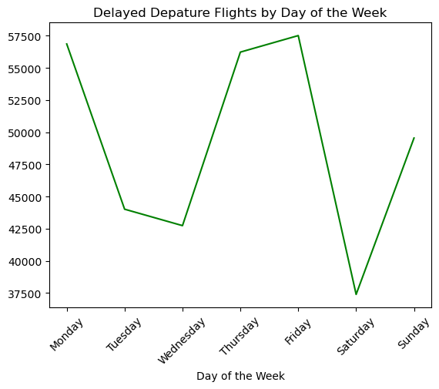
Answer
Based on our dataset (which covers 2015), delays are more likely to occur on Thursday, Friday or Monday flights.
On the other hand, delays are least likely to occur on Saturday.

Slide 13

3. First Quarter Data Analysis
Presenter: David Musili

Slide 14
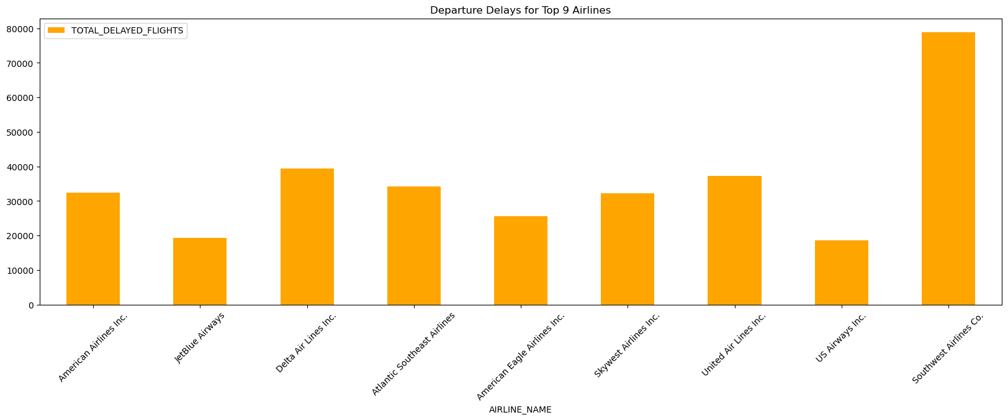
First Quarter Departure Delays by Airline
Based on the bar graph, Southwest airlines has 40,000 more flights delayed than its closest competitor (Delta Airlines).

Slide 15
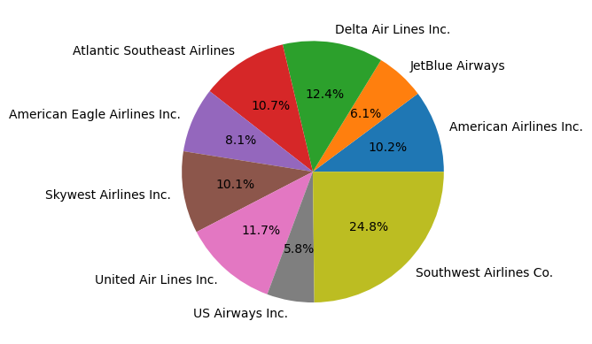
First Quarter Departure Delays by Airline
Based on the pie chart, Southwest airlines had 25% of all the delayed flights when compared to all the delayed flights from the top 9 airlines with the most delays.

Slide 16
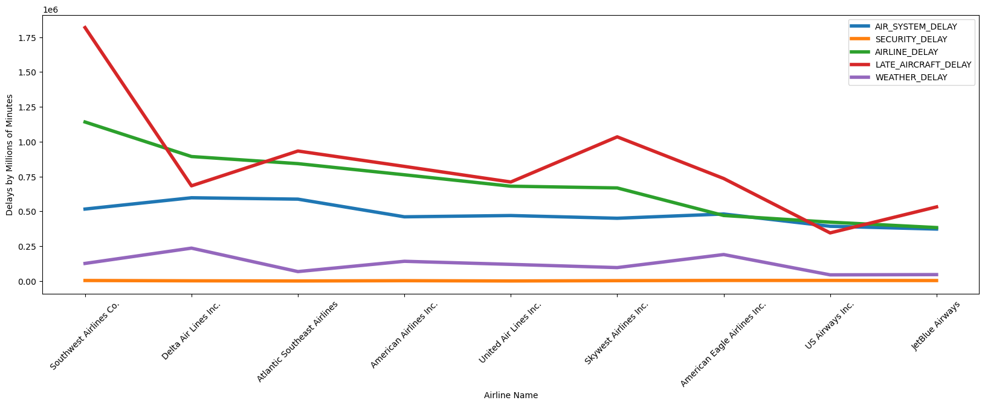
First Quarter Airline Flight Delays by Reason
Based on this line graph, weather and security delays are the least causes of all the flight delays. Also, most flight delays are caused by the airlines, with Southwest leading these delays.

Slide 17
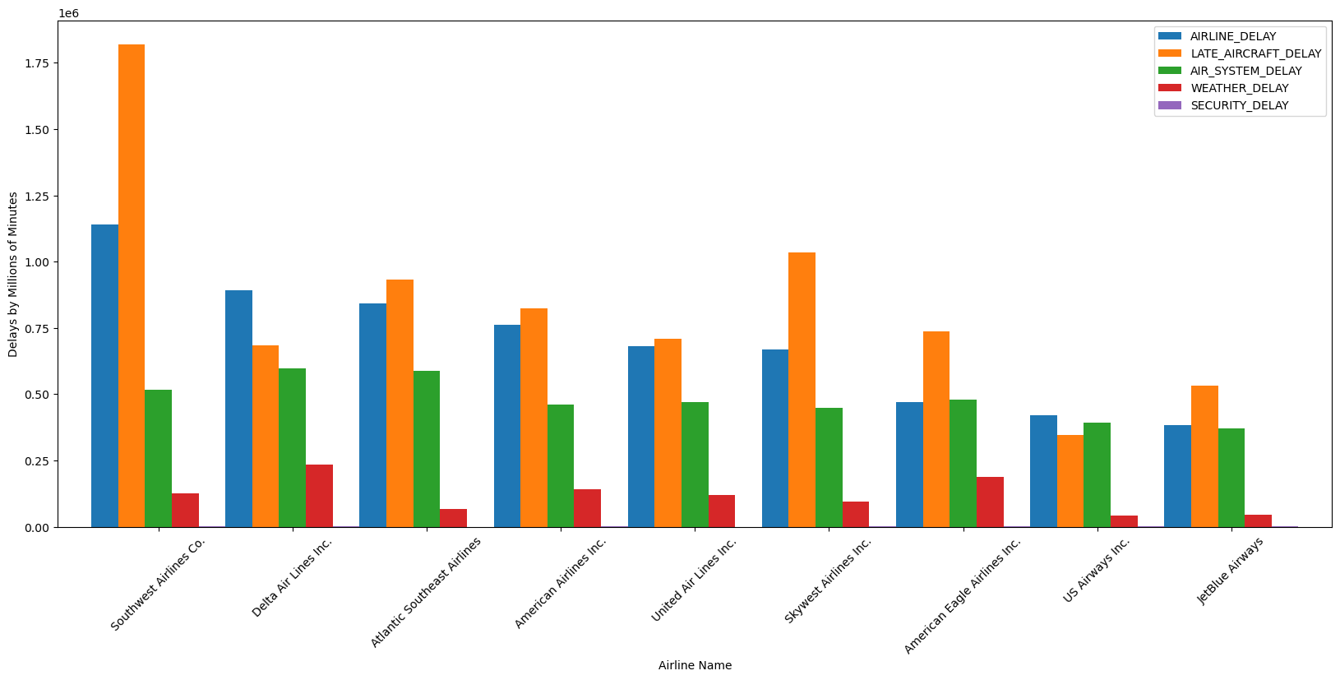
First Quarter Airline Flight Delays by Reason

Slide 18

3. Second Quarter Data Analysis
Presenter: Moez Vellani

Slide 19
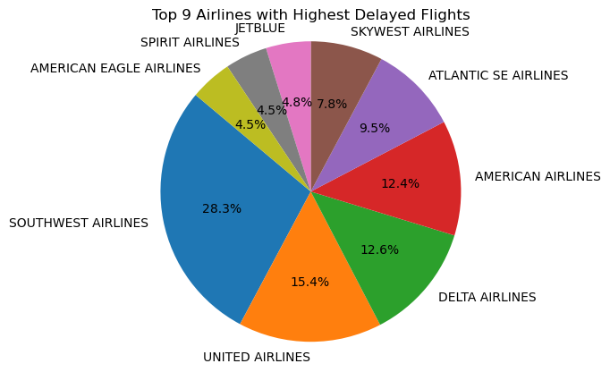
Second Quarter Total Delays by Airline
Through the second quarter, Southwest Airlines continues to be the airline with most delayed flights.

Slide 20
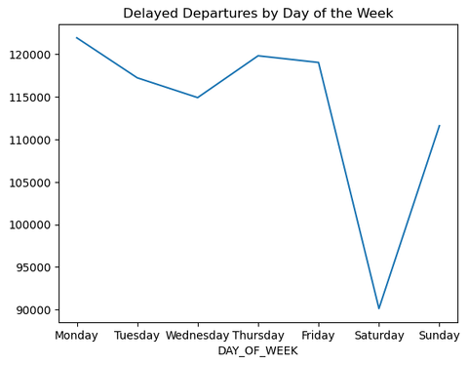
Second Quarter Daily Departure Delays
Monday had the highest number of delayed departure while Saturday had the least. According to this graph, the best day to travel without a delay is Saturday.

Slide 21
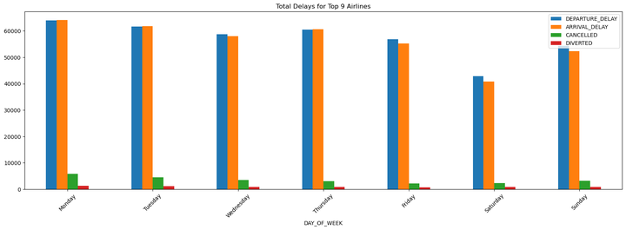
Second Quarter Daily Delayed Arrivals
As you can see, based on this graph, Departure Delays and Arrival delays are the prominent reasons for delays. As for cancelled an diverted flights, they are least likely to occur due to weather or mechanical reasons.

Slide 22

4. Third Quarter Data Analysis
Presenter: Sam Farrow

Slide 23
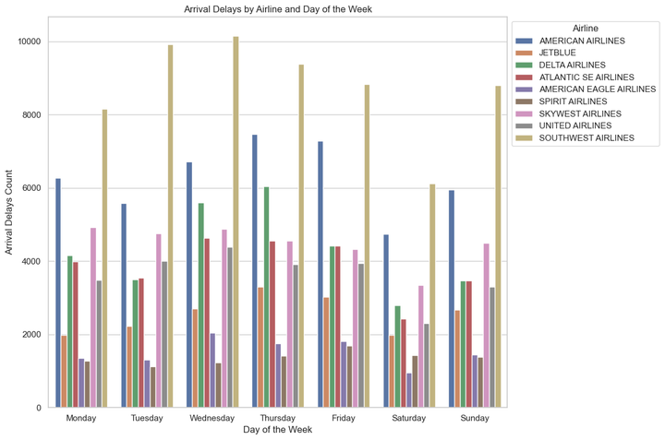
Arrival Delays by Airline by Day of the Week.
Wednesday has the most Arrival Delays whereas Saturday has the least, making Saturday the best day for travel

Slide 24
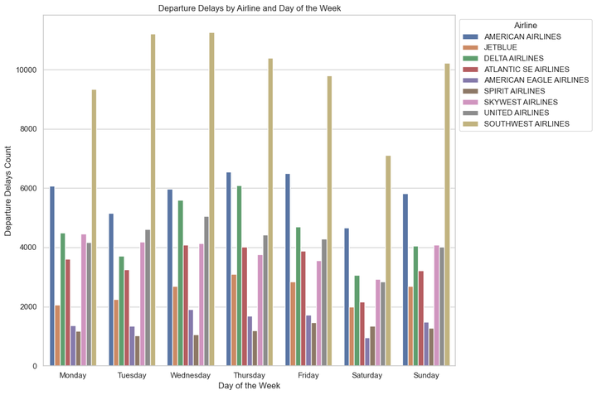
Departure Delays by Airline and Day of Week.
Wednesday has the most Departure Delays whereas Saturday has the least, making Saturday the best day for travel

Slide 25
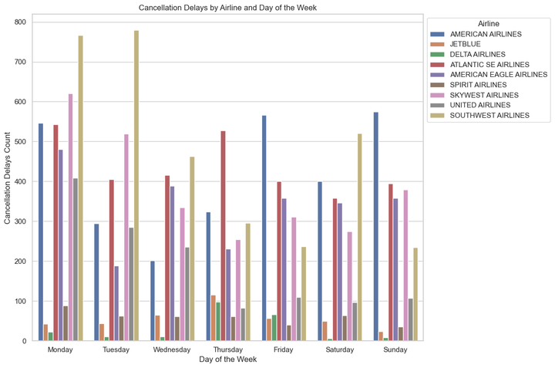
Cancellation Delays by Airline and Day of the Week
Monday and Tuesday has the most Cancellations for the week.

Slide 26
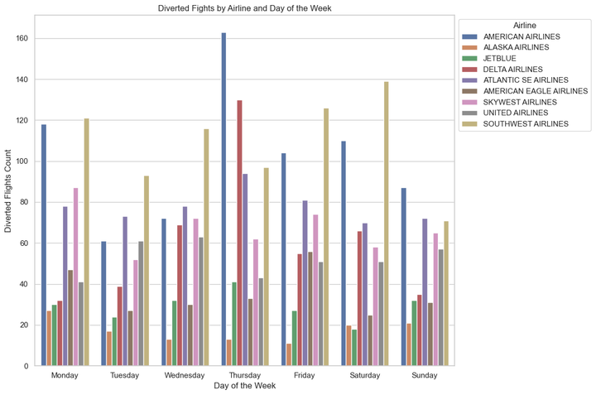
Diverted Flights by Airline and Day of the Week
Thursday has the most Diversions for the week.

Slide 27
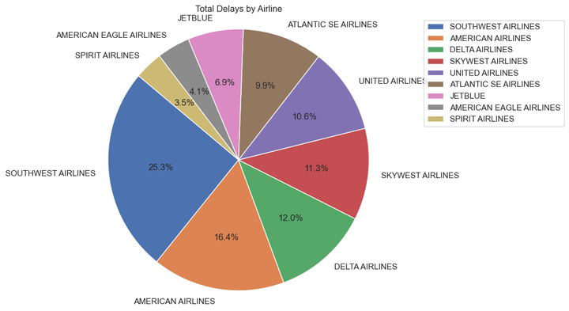
Third Quarter Total Delays by Airline
Southwest makes up 25% of all the total delays followed by American Airlines.

Slide 28
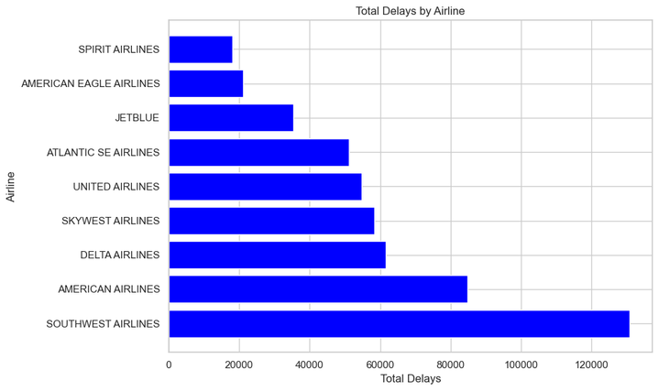
Third Quarter Total Delays by Airline
Southwest had over 120,000 flight delays followed its next closest competitor American with just over 80,000 delays.

Slide 29
5. Conclusions
1. Days with the most flight delays.
Delays are more likely to occur on Thursday, Friday or Monday flights.
2. Southwest Airlines has the most delays
Based on the data, Southwest Airlines had 75% more delays than its closest competitor (Delta Airlines)
3. Most of Southwest delays are due to its fleet arriving late
As compared to other airlines, Southwest delays are due to its flee arriving late.
4. Weather and Security delays are far fewer than is typically reported by the news media.
Compare to other types of delay, our data shows that weather and security delays are the least type of delays.

Slide 30

Thank you

